Slide 1
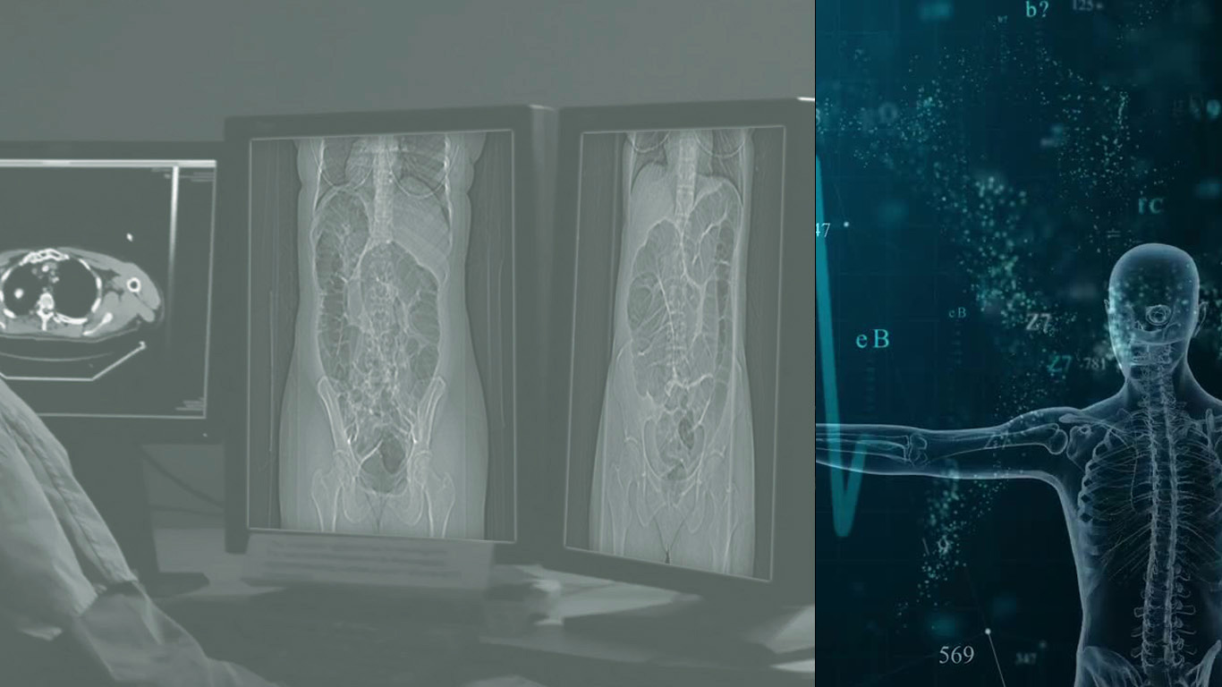
Medical Image Preprocessing and Convolutional Neural Network for Colorectal Cancer Image Classification
2019 2nd Asia Pacific Conference on Medical
and Health Science (APCMHS 2019), June 1-3, 2019
Seoul, South Korea
Natinai Jinsakul^{1,2}; Cheng-Fa Tsai²
¹Department of Tropical Agriculture and International Cooperation,
National Pingtung University of Science and Technology, Taiwan
²Department of Management Information Systems,
National Pingtung University of Science and Technology, Taiwan

Slide 2
Outline
Background
Objectives
Methodology
Results
Conclusion
Future works

Slide 3
1. Background
- Colorectal cancer is the top three leading deaths in humans (Huang,
Dou et al. 2018; Cancer.org, 2019; Fiedler, Fiedler et al. 2019)
- Widespread and increasing health problem (Paul and Brahma 2019).
- Spread to young people (Kasi, Shahjehan et al. 2019).
- Used of medical imaging and the artificial intelligence (AI) in terms of
in deep learning to assist in the process of diagnosing the disease
(Cao, Liu et al. 2018; Maier, Syben et al. 2018).
Notes:
Colorectal cancer is the top three leading cause of cancer-related deaths in humans (Huang, Dou et al. 2018; Cancer.org, 2019; Fiedler, Fiedler et al. 2019) that has become a widespread and increased health problem (Paul and Brahma 2019). Moreover, this disease has spread to young people (Kasi, Shahjehan et al. 2019).
However, this issue has used medical imaging and several computer science techniques; such as, artificial intelligence (AI) in terms of state-of-the-art in deep learning to assist in the process of diagnosing the disease (Cao, Liu et al. 2018; Maier, Syben et al. 2018).

Slide 4
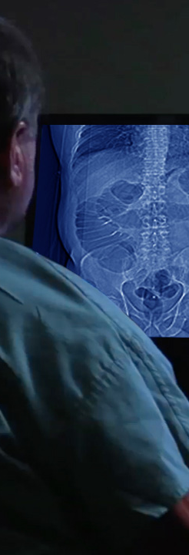
1. Background
- The medical image in kind of digital images (Liu, Hernandez-
Cabronero et al. 2017; Joris, Develter et al. 2018),
- Usage of processing to detection, screening and classification of
diseases (Vasuki, Kanimozhi et al. 2017).
- Medical images appear with noise, blurriness, poor contrast and
sharpness affect to false diagnosis,
- Image preprocessing for image enhancement (Vasuki, Kanimozhi et
al. 2017).
Notes:
With the increasing of applying the medical image in kind of digital images (Liu, Hernandez-Cabronero et al. 2017; Joris, Develter et al. 2018), it has the need for usage of processing to detection, screening and classification of diseases (Vasuki, Kanimozhi et al. 2017).
Medical images are appeared with noise, blurriness and may suffer due to poor contrast and sharpness which affect the results in false diagnosis, Image preprocessing for image enhancement is the crucial task of medical image processing (Vasuki, Kanimozhi et al. 2017).

Slide 5
2. Objectives
Employ image preprocessing and deep learning of a convolutional neural network (CNN) to classify images of colorectal cancer.
Compare the validation results of the image training and test between no preprocessing and the preprocessing of colorectal cancer images.
Notes:
The objectives of this study were to employ image preprocessing and deep learning of a convolutional neural network (CNN) to classify images of colorectal cancer and compare the validation results of the image training and test between no preprocessing and the preprocessing of colorectal cancer images.

Slide 6
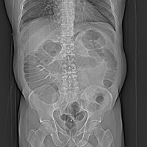
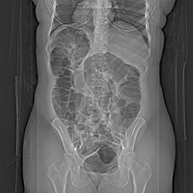
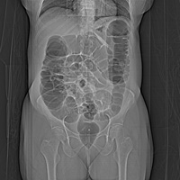
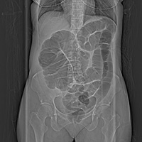
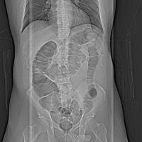
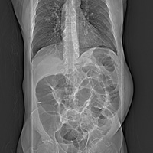
3. Methodology
CT colonography of The Cancer Imaging Archive (TCIA).
(Smith, Clark et al. 2015)
328 patients, 104 cancer and 224 normal patients.
Total CT Topogram of supine and prone images was 425 images.
201 cancer images and 224 non-cancer images.
Figure 1. example of CT Topogram colon images.
Notes:
The image dataset was collected from the CT colonography of The Cancer Imaging Archive (TCIA) and employed images from 328 patients, who were classified into 104 cancer patients and 224 normal patients. There was a total of 425 images comprising 201 cancer images and 224 non-cancer images.

Slide 7
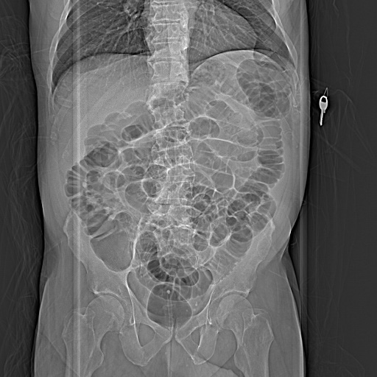
3. Methodology
Convert image of DICOM to JPEG format.
Image preprocessing with a center crop.
Center cropping by manually with Photoshop software.
Image center crop target specifically on the colon position.
NASNet image size requirement:
- NASNet Large 331 x 331
- NASNet Mobile 224 x 224
Figure 2. Original image
Notes:
All of the images used preprocessing with a center cropping that emphasized specifically on the colon.

Slide 8
3. Methodology
Image cropping is the most common method can improve the visual image quality and the overall composition by mainly operated to cut and remove areas of the noise and object unwanted content or irrelevant detail.
(Yan, Lin et al. 2013; Chen, Huang et al. 2017; Deng, Cui et al. 2018)
Figure 2. Original image
Notes:
All of the images used preprocessing with a center cropping that emphasized specifically on the colon.

Slide 9
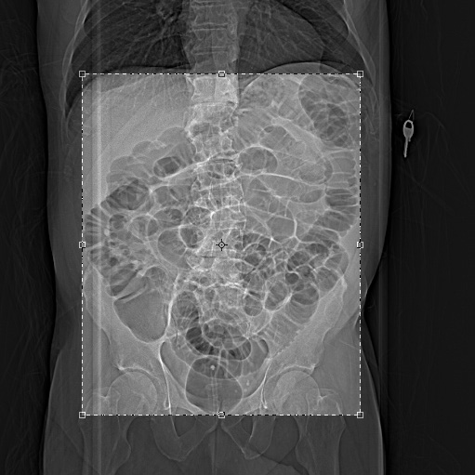
3. Methodology
Convert image of DICOM to JPEG format.
Image preprocessing with a center crop.
Center cropping by manually with Photoshop software.
Image center crop target specifically on the colon position.
NASNet image size requirement:
- NASNet Large 331 x 331
- NASNet Mobile 224 x 224
Figure 3. Center cropping
Notes:
All of the images used preprocessing with a center cropping that emphasized specifically on the colon.

Slide 10
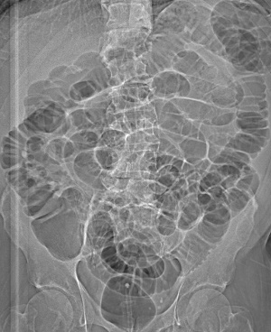
3. Methodology
Convert image of DICOM to JPEG format.
Image preprocessing with a center crop.
Center cropping by manually with Photoshop software.
Image center crop target specifically on the colon position.
NASNet image size requirement:
- NASNet Large 331 x 331
- NASNet Mobile 224 x 224
Figure 4. Image of center crop result
Notes:
All of the images used preprocessing with a center cropping that emphasized specifically on the colon.

Slide 11
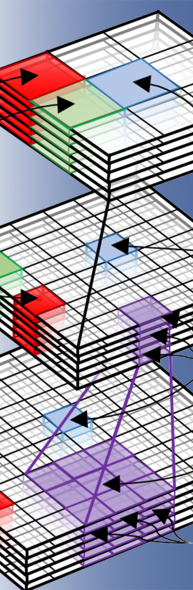
3. Methodology
NASNet (Zoph, Vasudevan et al. 2017), This model Inspired by the recently proposed Neural Architecture Search (NAS) (Zoph and Le 2016) framework. In NAS, a controller recurrent neural network (RNN) samples child networks with different architectures.
CIFAR10 image, NASNet model achieves an error rate of 2.40%, which is better than the previous model of 2.56%. And The best single run achieves 2.19% error rate.
ImageNet image, NASNet achieves the accuracy of 82.7% was a top-1 and 96.2% top-5. This result amounts to a 1.2% improvement in top-1 accuracy.

Slide 12
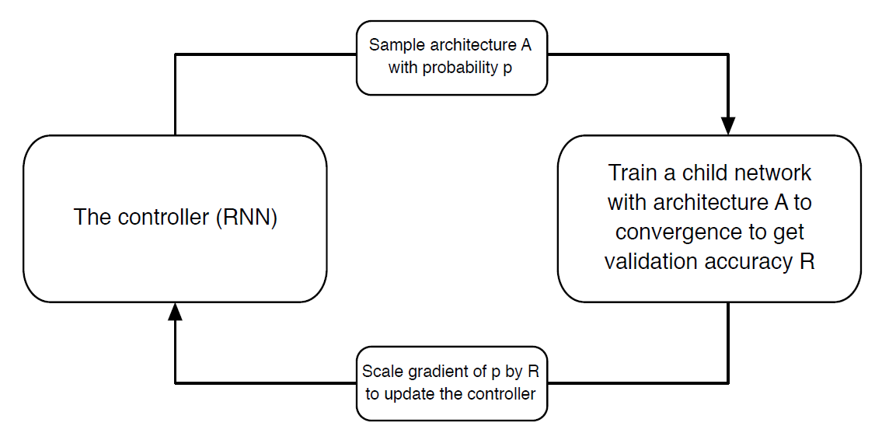
3. Methodology
Figure 5. overview of NAS (Neural Architecture Search)
(Zoph and Le 2016)
Notes:
Figure 5 is the overview of Neural Architecture Search.
- A controller RNN predicts architecture A from a search space with probability p.
- A child network with architecture A is trained to convergence achieving accuracy R.
- Scale the gradients of p by R to update the RNN controller.

Slide 13
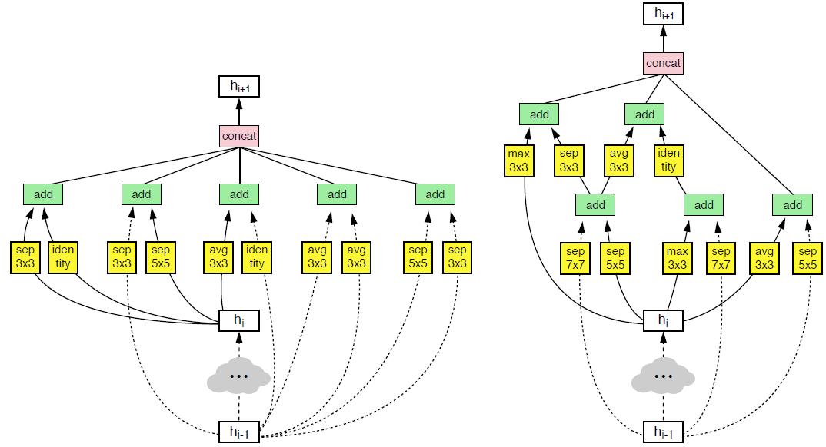
3. Methodology
- Define building blocks
- Obtain accuracy
- Obtain validation set
- Update the controller
- Create better architecture
Normal cell
Reduction cell
Figure 6. Architecture of the best convolutional cells of NASNet
Notes:
The NASNet architecture defining a set of building blocks proposes for an image recognition network.
This architecture trained to convergence to obtain accuracy on a validation set.
The resulting accuracies are used to update the controller for generating better architectures by selecting better blocks or making better connections.
The controller weights are updated with a policy gradient.

Slide 14
3. Methodology
- White
The hidden state and input
image.
- Pink is the result.
- Yellow single block to two
primitive.
- Green is a combination.
Normal cell
Reduction cell
Figure 6. Architecture of the best convolutional cells of NASNet
Notes:
The white is the hidden state from the input image.
The pink is the result of a concatenation operation across all resulting branches.
A single block corresponds to two primitive operations (yellow) and a combination operation (green).

Slide 15
3. Methodology
Validation calculation indices:
Average accuracy
Average precision
Average recall
F1 measure.
Notes:
Validating the indices calculation of the average accuracy, average precision, average recall and F1 measure. In addition, all of the results of the validated indices were compared with the validation results of the original images without preprocessing.

Slide 16
3. Methodology
Computer equipments:
CPU i7-6700 3.40GHz
RAM of 12 GB
GPU NVIDIA GeForce GTX 1060, 6 GB.
Software and language:
Keras
Tensorflow
Python
NASNet architectures determine:
Training and test split data on 80/20
Optimizer of rmsprop
Dropout equal 0.5
Batch size 24
Epochs 100

Slide 17
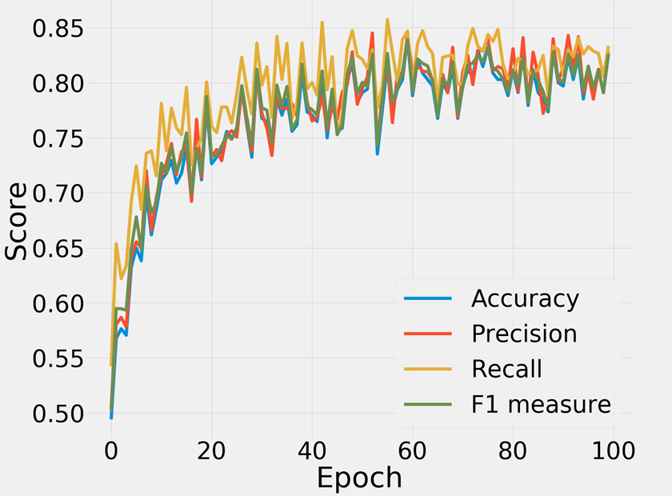
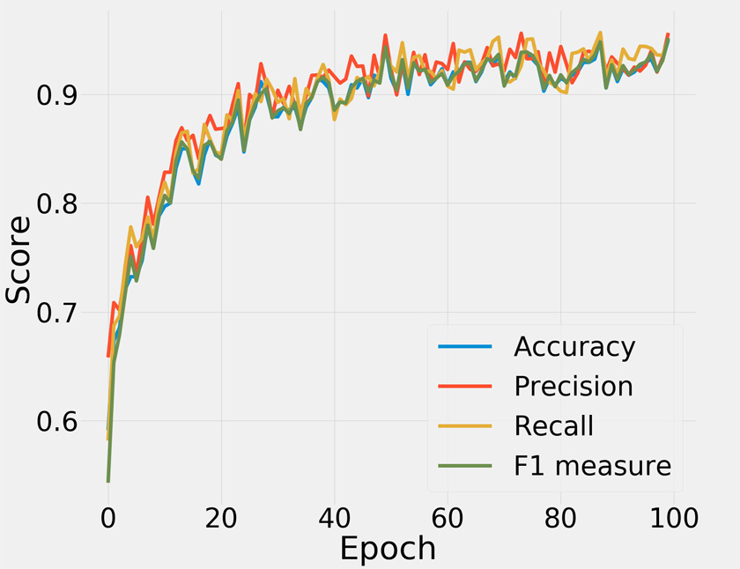
4. Results
Using original image
Figure 7. result of NASNet Mobile
by using original image
Figure 8. result of NASNet Large
By using original image

Slide 18
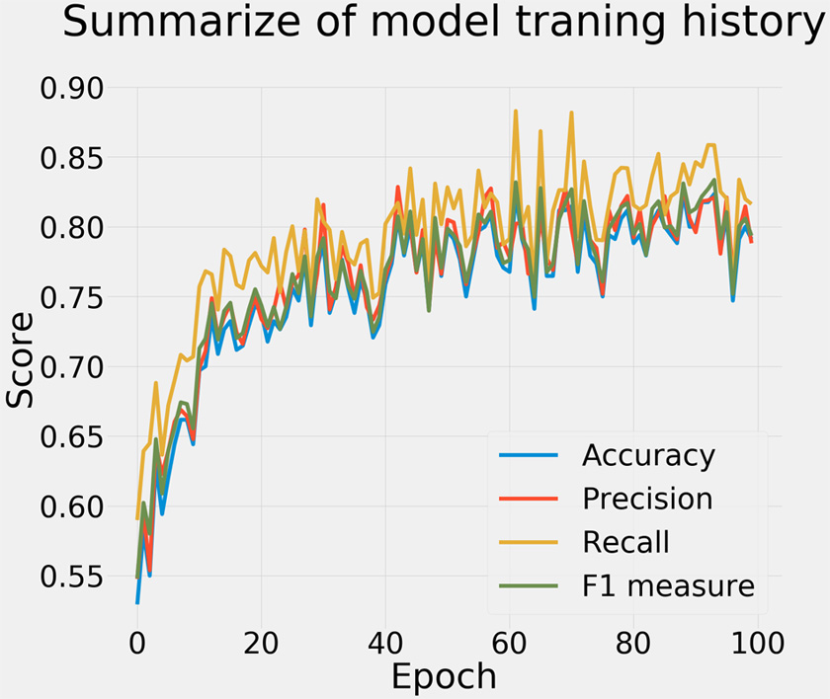
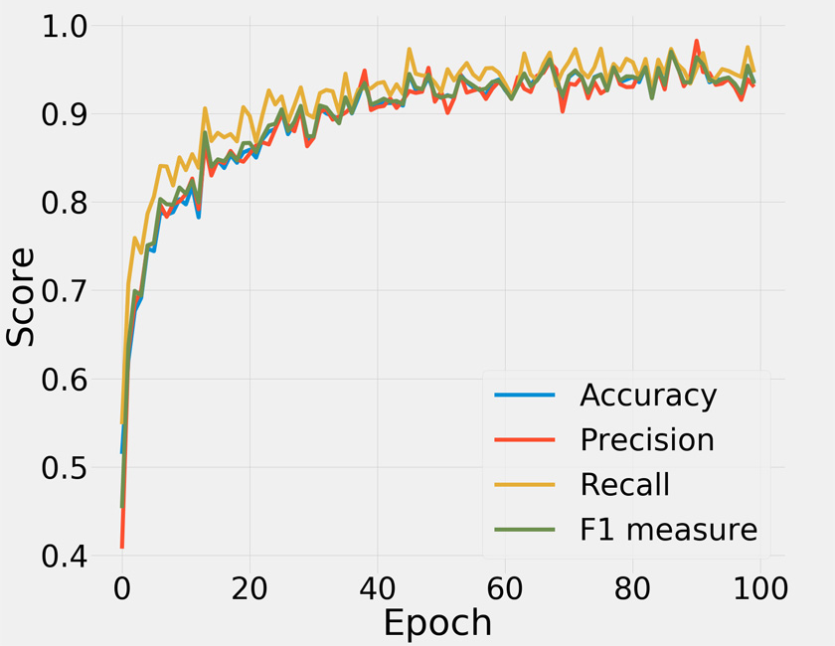
4. Results
Preprocessing with center cropping
Figure 9. result of NASNet Mobile
with center cropping
Figure 10. result of NASNet Large
With center cropping

Slide 19
4. Results
Table 1. validation results of NASNet Mobile and Large
 | Original image |  |  |  | Preprocessing with center cropping
 | Avg. Accuracy | Avg. Precision | Avg. Recall | F1 | Avg. Accuracy | Avg. Precision | Avg. Recall | F1
NASNetMobile | 75.61 | 76.39 | 79.09 | 76.39 | 76.57 | 77.2 | 79.45 | 77.17
NASNetLarge | 88.42 | 89.65 | 89.25 | 88.46 | 89.41 | 89.19 | 91.48 | 89.62
Notes:
The validation results of the training and test with the CNN on no image preprocessing had an average accuracy of 88.42%, average precision of 89.65%, average recall of 89.25%, and F1 measure equal to 88.46%.
The validation results from using the image preprocessing training and test with the CNN for image classification had an average accuracy score of 89.41%, average precision of 89.19%, average recall of 91.48% and F1 measure equal to 89.62%.

Slide 20
5. Conclusions
The operation of the image preprocessing by using a center crop that focused specifically on the images was able increase the accuracy of the image classification.
thus, the validation indices results proved to be better than using the original images.
Furthermore, the method in this paper could be applied to other medical image problems and other fields relevant to image classification.

Slide 21
6. Future works
- Image Preprocessing
In the forward work need to an automatic image cropping algorithm for more conveniently.
(Jaiswal and Meghrajani 2015; Deng, Cui et al. 2018)
- 6 Major improvements on CNNs (Gu, Wang et al. 2015):
1. Convolutional Layer
2. Pooling Layer
3. Activation Function
4. Loss Function
5. Regularization
6. Data Augmentation
Notes:
We will concentrate on getting more accuracy score. In the next work we will conduct in the following:
Image Preprocessing
- In the process of image preprocessing we still using image cropping method, However on the image cropping method on this paper just by manually. In the forward work need to an automatic image cropping algorithm for more conveniently. The method such as SVM, Image segmentation and CNN.
(Jaiswal and Meghrajani 2015; Deng, Cui et al. 2018)
6 Major improvements on CNNs (Gu, Wang et al. 2015):
- Convolutional Layer
- Pooling Layer
- Activation Function
- Loss Function
- Regularization
- Data Augmentation

Slide 22
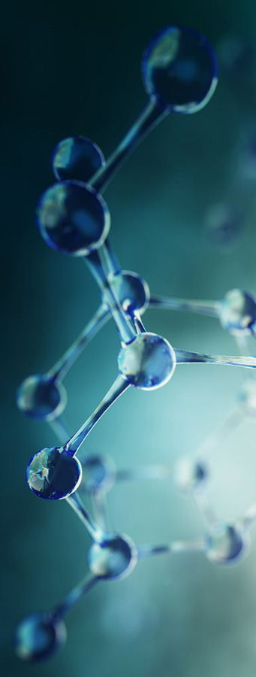
Acknowledgments
Ministry of Science and Technology of the Republic of China, Taiwan
National Pingtung University of Science and technology, Taiwan
Suratthani Rajabhat University, Thailand
2019 2nd Asia Pacific Conference on Medical and Health Science
Notes:
For gave the changes scholarship and financial support on this research.

Slide 23
References
Cao, C., et al. (2018). "Deep Learning and Its Applications in Biomedicine." Genomics, Proteomics & Bioinformatics 16(1): 17-32.
Chen, Y.-L., et al. (2017). "Quantitative Analysis of Automatic Image Cropping Algorithms: A Dataset and Comparative Study."
eprint arXiv:1701.01480: arXiv:1701.01480.
Deng, X., et al. (2018). Automatic image cropping with a single fully convolutional network. Proceedings of the 10th International Conference on Internet Multimedia Computing and Service. Nanjing, China, ACM: 1-5.
Fiedler, B., et al. (2019). "Underutilization of Aspirin in Patients With Advanced Colorectal Polyps." The American
Journal of Medicine.
Gu, J., et al. (2015). "Recent Advances in Convolutional Neural Networks." eprint arXiv:1512.07108: arXiv:1512.07108.
Huang, Y., et al. (2018). HL-FCN: Hybrid loss guided FCN for colorectal cancer segmentation. 2018 IEEE 15th International Symposium on Biomedical Imaging (ISBI 2018).
Jaiswal, N. and Y. K. Meghrajani (2015). Saliency based automatic image cropping using support vector machine
classifier. 2015 International Conference on Innovations in Information, Embedded and Communication Systems.
Joris, P., et al. (2018). "Preprocessing of Heteroscedastic Medical Images." IEEE Access 6: 26047-26058.
Kasi, P. M., et al. (2019). "Rising Proportion of Young Individuals With Rectal and Colon Cancer." Clinical Colorectal Cancer
18(1): e87-e95.
Liu, F., et al. (2017). "The Current Role of Image Compression Standards in Medical Imaging." Information 8(4).

Slide 24
References
Maier, A., et al. (2018). "A Gentle Introduction to Deep Learning in Medical Image Processing." eprint arXiv:1810.05401:
arXiv:1810.05401.
Paul, S. and D. Brahma (2019). "An Integrated Approach for Identification of Functionally Similar MicroRNAs in Colorectal
Cancer." IEEE/ACM Transactions on Computational Biology and Bioinformatics 16(1): 183-192.
Smith K, Clark K, Bennett W, Nolan T, Kirby J, Wolfsberger M, Moulton J, Vendt B, Freymann J. (2015). Data From CT_COLONOGRAPHY. The Cancer Imaging Archive. http://doi.org/10.7937/K9/TCIA.2015.NWTESAY1.
Sokolova, M. and G. Lapalme (2009). "A systematic analysis of performance measures for classification tasks." Information Processing & Management 45(4): 427-437.
Vasuki, P., et al. (2017). A survey on image preprocessing techniques for diverse fields of medical imagery. 2017 IEEE International Conference on Electrical, Instrumentation and Communication Engineering (ICEICE).
Yan, J., et al. (2013). Learning the Change for Automatic Image Cropping. 2013 IEEE Conference on Computer Vision and Pattern
Recognition.
Zoph, B. and Q. V. Le (2016). "Neural Architecture Search with Reinforcement Learning." eprint arXiv:1611.01578: arXiv:1611.01578.
Zoph, B., et al. (2017). "Learning Transferable Architectures for Scalable Image Recognition." eprint arXiv:1707.07012:
arXiv:1707.07012.

Slide 25
Thank you for your attention

Slide 27
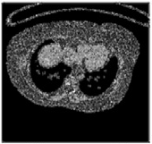
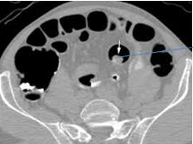
Related works
Table 2. Literature reviews
Title | Journal | Detail
1. A novel end-to-end classifier using domain transferred deep convolutional neural networks for biomedical images (Pang, Yu et al. 2017) | Computer Methods and Programs in Biomedicine | Developed a deep learning architecture based on the raw pixels of original biomedical images. The data augmentation method and fast convergence speed, the algorithm of this work can achieve the best accuracy rate and outstanding classification ability for biomedical images of colon image.
2. Automated Detection of Polyps in CT Colonography images using Deep Learning Algorithms in Colon Cancer Diagnosis (Godkhindi et al. 2017) | International Conference on Energy, Communication, Data Analytics and Soft Computing | Convolution Neural Network (CNN) and the results are compared with classical machine learning algorithms is Random Forest (RF) and k-nearest neighbor (KNN) using medical images includes colon and lungs for polyp detection.
Image dataset

Slide 28
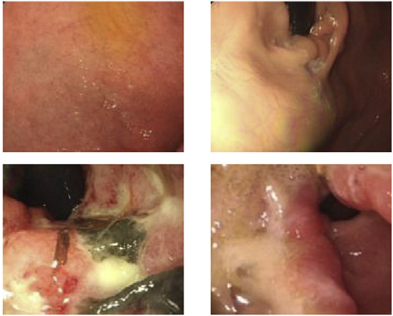
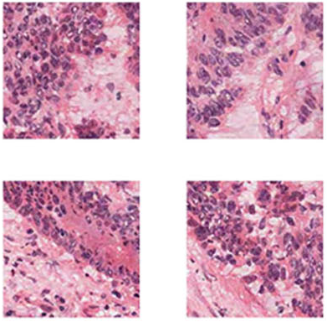
Related works
Table 2. Literature reviews
Title | Journal | Detail
3. Look-behind fully convolutional neural network for computer-aid edendoscopy (Diamantis et al. 2019) | Biomedical Signal Processing and Control | A novel Fully CNN named Look-Behind FCN architecture aiming to aid the detection of abnormalities the algorithm suitable for training with smaller datasets. This is particularly useful in medical image analysis. The performance evaluated on flexible and wireless capsule endoscopy datasets, reaching to 99.72%.
4. Tumor Identification in Colorectal Histology Images Using a Convolutional Neural Network (Yoon, Lee et al. 2019) | Journal of Digital Imaging | Developed five modification algorithms of the system from the Visual Geometry Group (VGG). The first result modified VGG configuration for our partial dataset, resulting in accuracy up to 94%. Second results of using the entire dataset on the modified VGG-E configuration, accuracy up to 95%, which equates to correct classification.
Image dataset

Slide 29
Extended results
Table 3. validation results of different kind of CNN architectures.
 | Original image |  |  |  | Preprocessing with center cropping
 | Avg accuracy | Avg precision | Avg recall | F1 | Avg accuracy | Avg precision | Avg recall | F1
InceptionResNetV2 | 73.1 | 73.49 | 77.52 | 73.85 | 75.8 | 75.87 | 79.78 | 76.33
Inceptionv3 | 81.14 | 82.02 | 84.29 | 81.74 | 79.59 | 80.25 | 83.06 | 80.2
NASNetLarge | 88.42 | 89.65 | 89.25 | 88.46 | 89.41 | 89.19 | 91.48 | 89.62
NASNetMobile | 76.57 | 77.2 | 79.45 | 77.17 | 75.61 | 76.39 | 79.09 | 76.39
ResNet50 | 85.18 | 85.19 | 87.19 | 85.58 | 83.36 | 86.27 | 88.71 | 86.57
VGG16 | 83.75 | 85.42 | 84.53 | 83.32 | 84.01 | 85.74 | 85.04 | 83.69
VGG19 | 83.44 | 85.43 | 84.4 | 83.25 | 84.64 | 86.16 | 85.62 | 84.31
Xception | 81.02 | 81.23 | 84.59 | 81.64 | 79.11 | 79.5 | 82.95 | 79.83

Slide 30
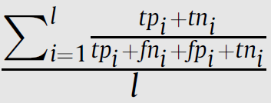
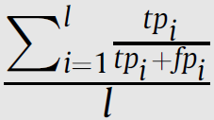
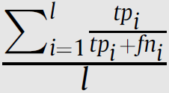
Validation indices equation
Table 4. Measure for multi-class classification based on a generalization (Sokolova and Lapalme 2009).
- Class define with C_{i}: - tp_{i} are true positive - fp_{i} false positive
- fn_{i} false negative - tn_{i} true negative - M indicate micro and macro-average.
Measure | Formula | Detail
Average Accuracy |  | The average per-class effectiveness of a classifier
Precision_{M} |  | An average per-class agreement of the data class labels with those of a classifiers
Recall_{M} |  | An average per-class effectiveness of a classifier to identify class labels
F1-measure |  | Relations between data’s positive labels and those given by a classifier based on a per-class average
Notes:
Validating the indices calculation of the average accuracy, average precision, average recall and F1 measure. In addition, all of the results of the validated indices were compared with the validation results of the original images without preprocessing.

